Slide 1
GRAPHS IN SENTIMENT ANALYSIS PROJECT

Slide 2
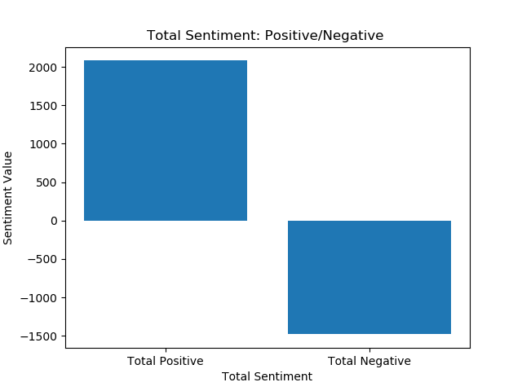
data set for Total Sentiment: Positive/Negative :
[2081.8304363029592, -1481.106017300224]
Conclusions Drawn:-
1. The general sentiment as can be seen is positive and is greater than the negative sentiment by 600.7244190027632.

Slide 3
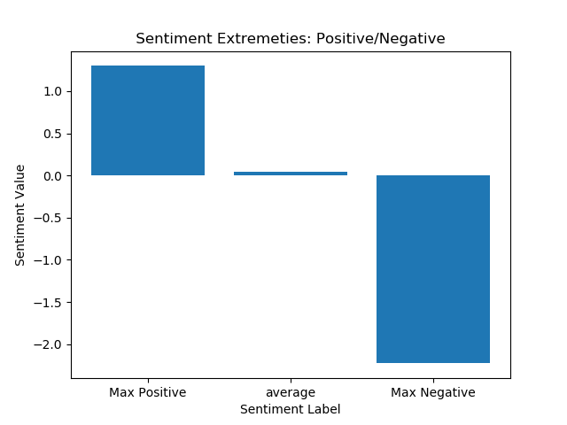
data set for Sentiment Extremities: Positive/Negative:
[1.299867367239363, 0.04020913112468294, -2.2283440581246223]
Conclusions drawn:-
The maximum positive sentiment is around 1.299(greater by 3.527) while the maximum negative sentiment is around -2.228

Slide 4
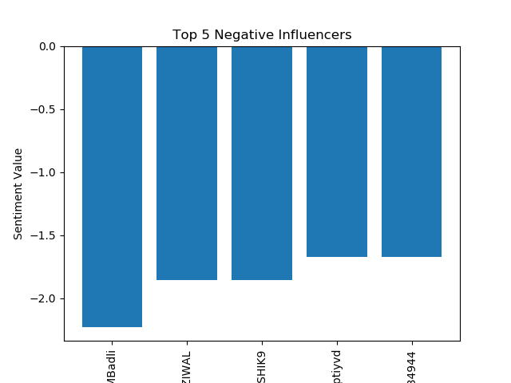
data set for Top 5 Negative Influences:
['CPIMBadli' 'HASHTAGFARZIWAL' 'PRAMODKAUSHIK9' 'deeptiyvd'
'rahulja13034944']

Slide 5
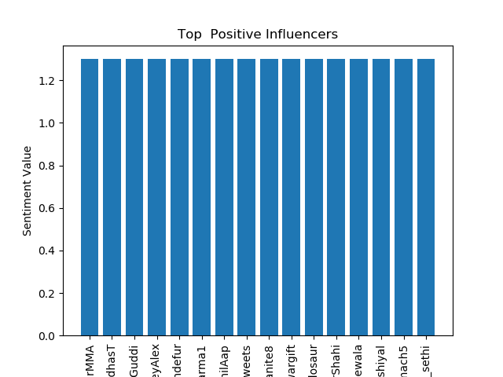
data set for Top Positive Influences:
['1DharMMA' 'AniruddhasT' 'Hello_Guddi' 'JusteyAlex' 'JustinSandefur'
'Mridul_Sharma1' 'MuzzammilAap' 'Nischaytweets' 'Reaganite8'
'Saquibanwargift' 'Stupidosaur' 'SukhvinderShahi' 'golgappewala'
'hemant_shiyal' 'iridemach5' 'pavan_sethi']
[1.29986737 1.29986737 1.29986737 1.29986737 1.29986737 1.29986737
1.29986737 1.29986737 1.29986737 1.29986737 1.29986737 1.29986737
1.29986737 1.29986737 1.29986737 1.29986737]
Conclusions drawn:-
1. The top(16) positive influencers all share the same sentiment value 1.2998

Slide 6
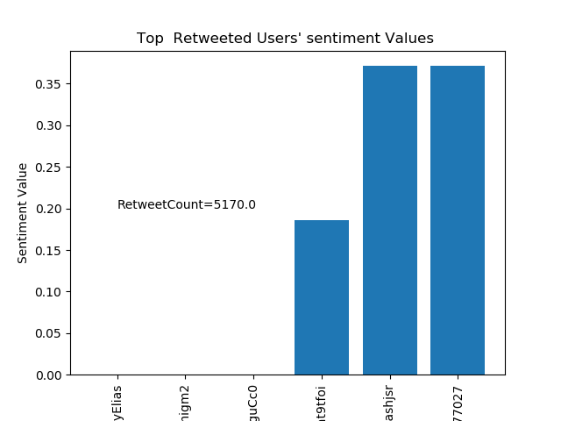
data set for Top Re-tweeted Users' sentiment Values:
['1SunnyElias' 'apoliceshanigm2' 'sxP6DbxfufguCc0' 'rayyat9tfoi'
'subhashjsr' 'Krishna20977027']
[0. 0. 0. 0.18569534 0.37139068 0.37139068]
Conclusions drawn:-
1. Out of the 6 top retweeted Users half have a neutral sentiment value as can be seen from graph.

